Slide 1
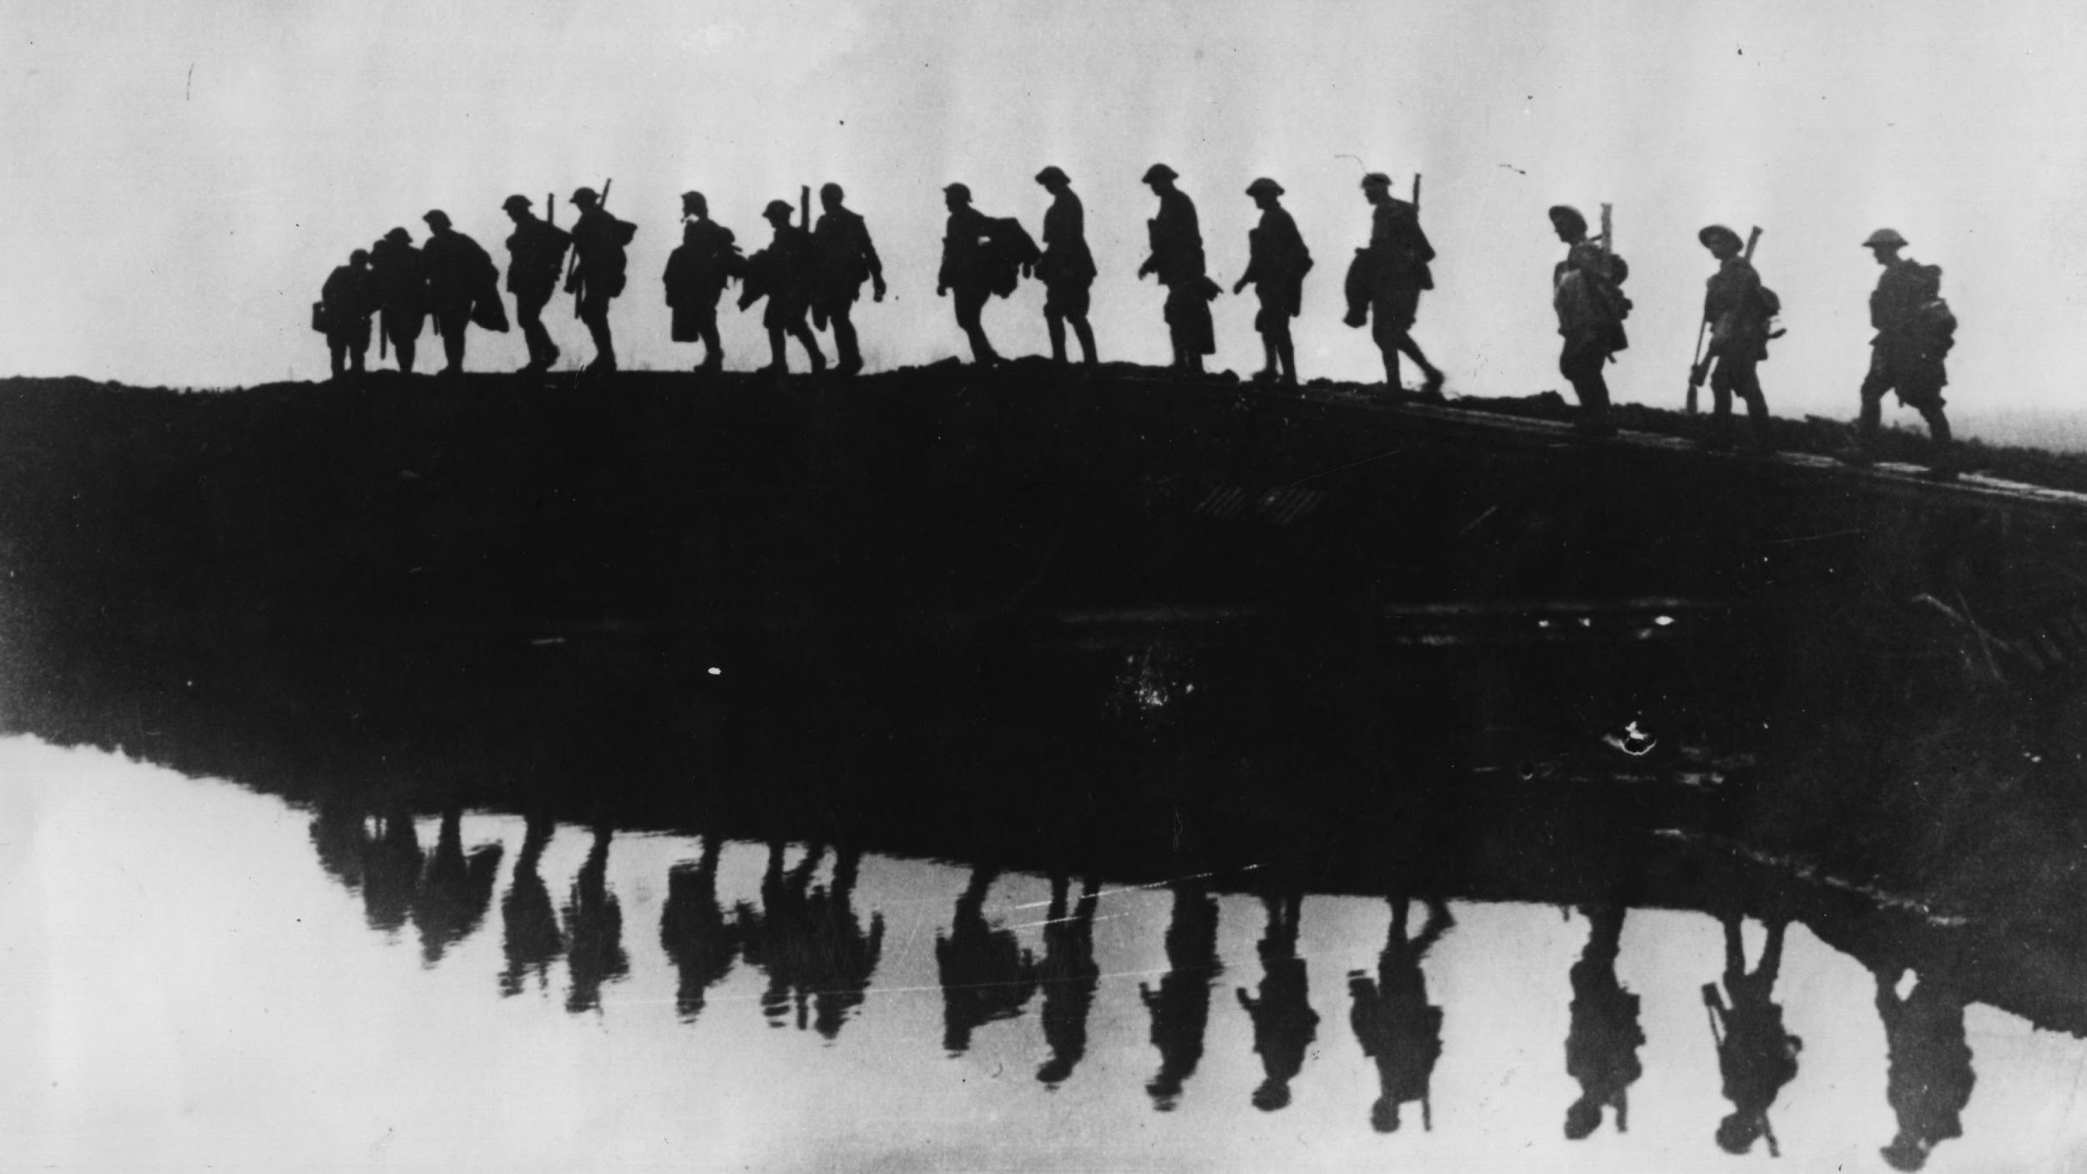
World War 1: Unraveled
Kenneth Sanders, Jacob Stephens, Aliyu Zakari

Slide 2

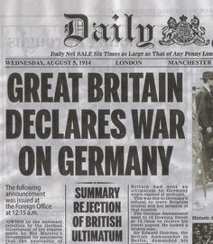
What we plan to do
World War I is often neglected in modern history classes even though it was the cause of World War II and the shape of modern European nations.
The goal is to create a website that is engaging that will aid in the education on this topic

Slide 3

Motivation
Lack of Education on WWI in American Education System
Lack of knowledge on the Global Impact of World War 1 (British Council)
Creating a mobile friendly educational site on this topic

Slide 4
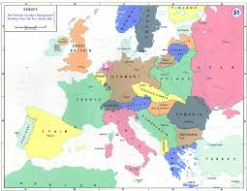
What we will cover
Prewar Conditions
Each year of the war and major battles within each year.
Major non-war events like the Russian Revolution and Armenian Genocide
Post War and events leading up to World War 2

Slide 5
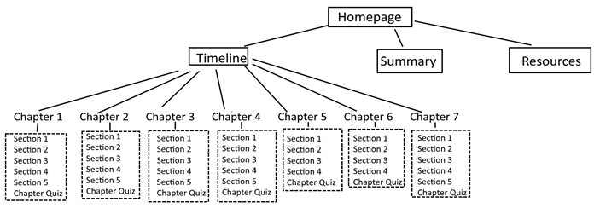
How we plan to do it
Client side website using javascript/css/html
Will be structured into 7 chapters, with 4 - 5 sections in each
Each chapter will include images and interactive modules.
Quiz at the end of each section, with the ability to mail the scores to a teacher or professor - we didn’t believe this needed to be secure, so it allowed us to not need a secure server.

Slide 6
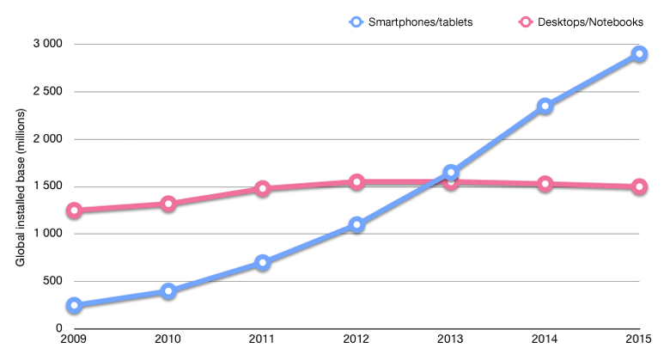

Audience and Use
Audience Target is High School Students and young Adults
Can be used as a classroom supplement or personal use.
Mobile UI easier for teenagers to use on phone versus Computer.
Will have desktop UI added on once the core site is created.

Slide 7
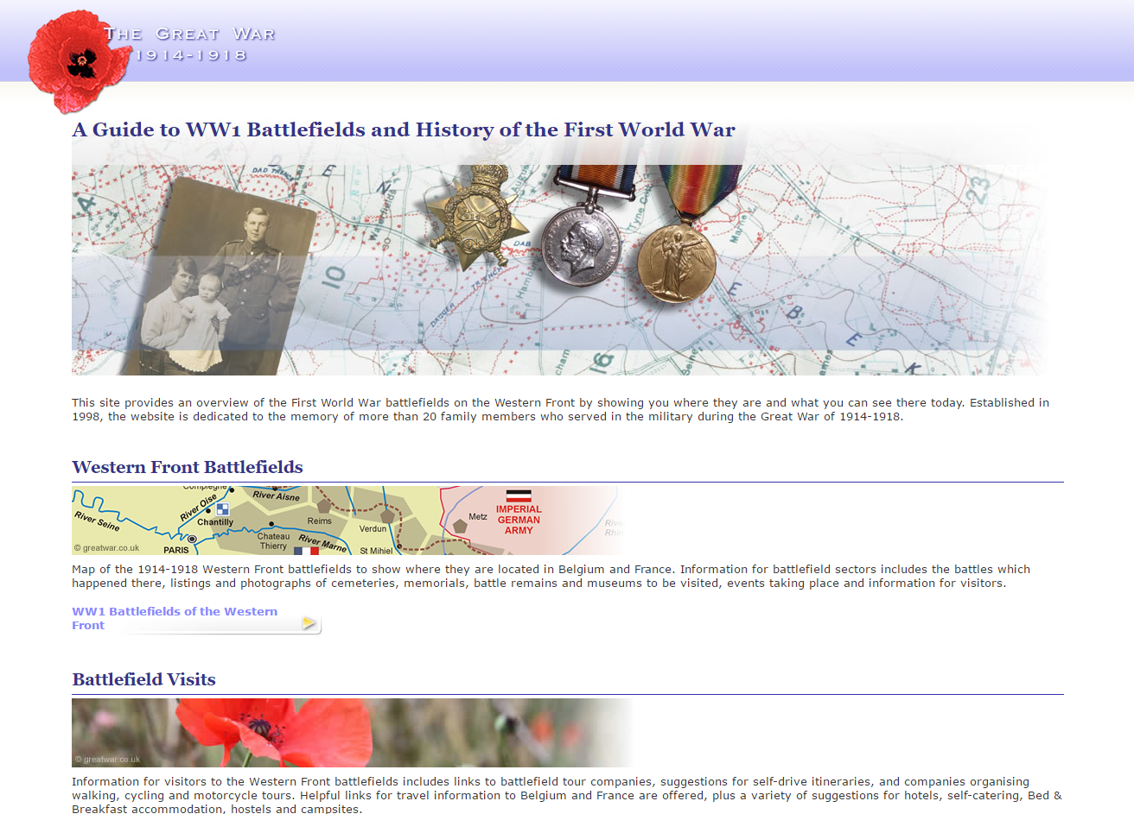
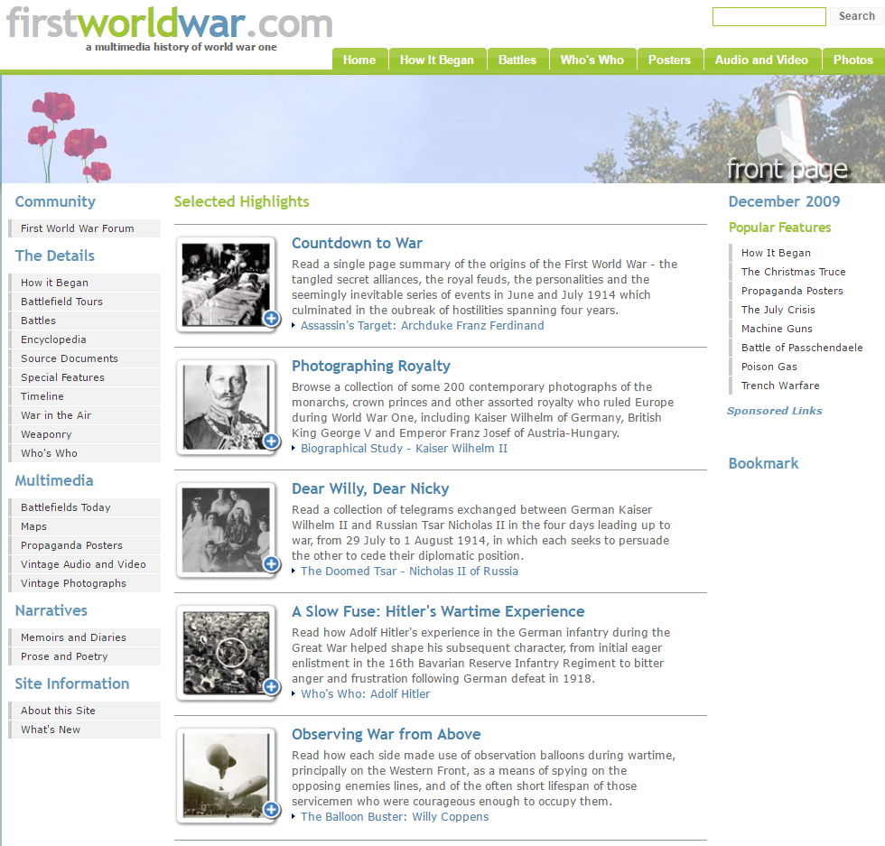
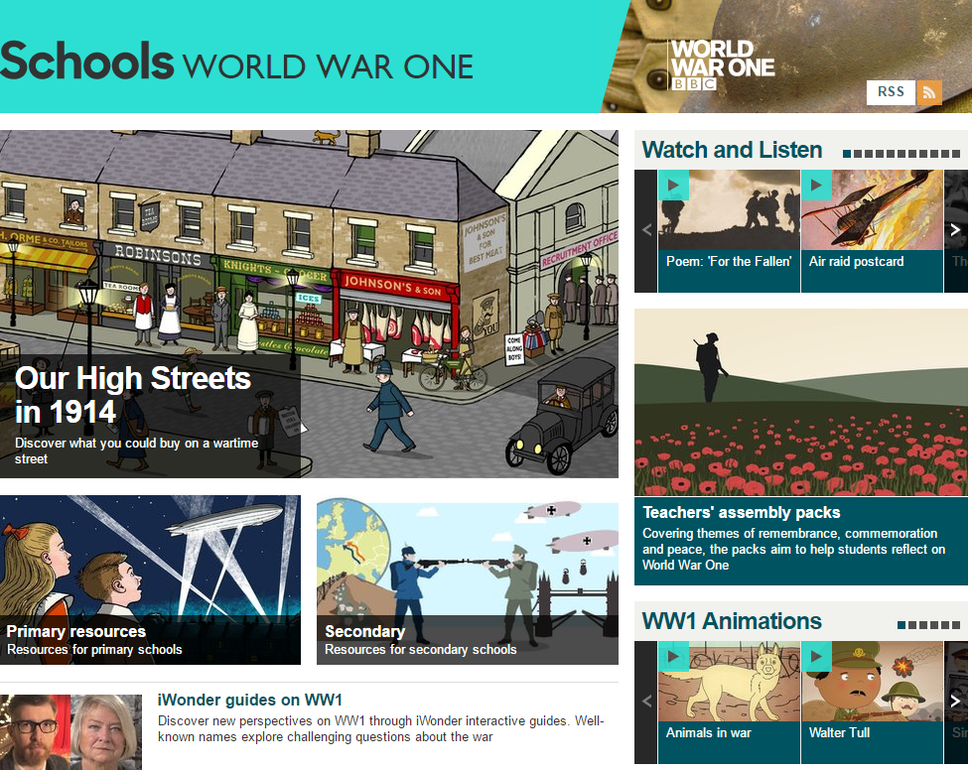
Previous work
www.greatwar.co.uk - Summarizes battlefields and helps plan trips
http://www.firstworldwar.com/ - Simplified details of WW1 with multimedia
http://www.bbc.co.uk/schools/0/ww1/ - WW1 educational site for younger children

Slide 8
Image credits
http://www.usnews.com/cmsmedia/df/e3/82d8711e4ff4ac630a4bd40b44c3/140723-editorial.jpg
http://2.bp.blogspot.com/-_KPr59U72wU/Tct-MVbDJEI/AAAAAAAAABk/O2K4n8rDIKs/w1200-h630-p-k-nu/destroy%2Bthis%2Bmad%2Bbrute.jpg
https://s-media-cache-ak0.pinimg.com/236x/96/f2/71/96f2718778ae2b815fda42f516137df5.jpg
https://images-na.ssl-images-amazon.com/images/I/31uT8opGysL._SX342_.jpg
https://cdn1.vox-cdn.com/assets/4620775/postwar_europe.png
https://media.mnn.com/assets/images/2015/05/kids-cellphones-school.jpg.653x0_q80_crop-smart.jpg
http://digitics.in/wp-content/uploads/2014/05/mobile_vs_desktop_internet.png
www.greatwar.co.uk
http://www.firstworldwar.com/
http://www.bbc.co.uk/schools/0/ww1/

